Slide 1
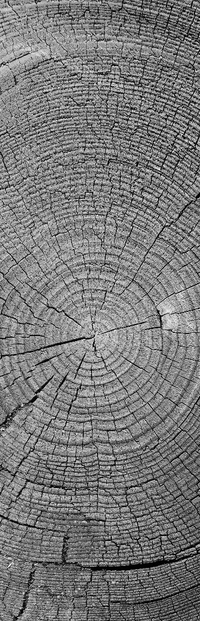

ARUDINO BASED WEATHER STATION WITH IOT
SRI MOOGAMBIGAI POLYTECHNIC COLLEGE MADHAMPATTI
DEPARTMENT OF ELECTRICAL AND ELECTROINCS ENGINEERING
Date:28/02/2024
BATCH MEMBERS :
22311879 HARISHKANNA R
22311885 POOVARASAN M
22311886 PRADEEP KUMAR R
22396058 DHARANESH S
22396059 LOKESHWARAN T
22396075 SUDHAKAR S
SUPERVISOR :
ANBARASAN R S
(LECTURE/eee)

Slide 2
INTRODUCTION
An Arduino weather station with IoT capabilities is a project that involves creating a device to monitor and collect weather-related data using Arduino microcontrollers and sensors, and then transmitting this data to the Internet for remote access and analysis.
The combination of Arduino and IoT technology allows for the creation of a versatile weather monitoring system.

Slide 3
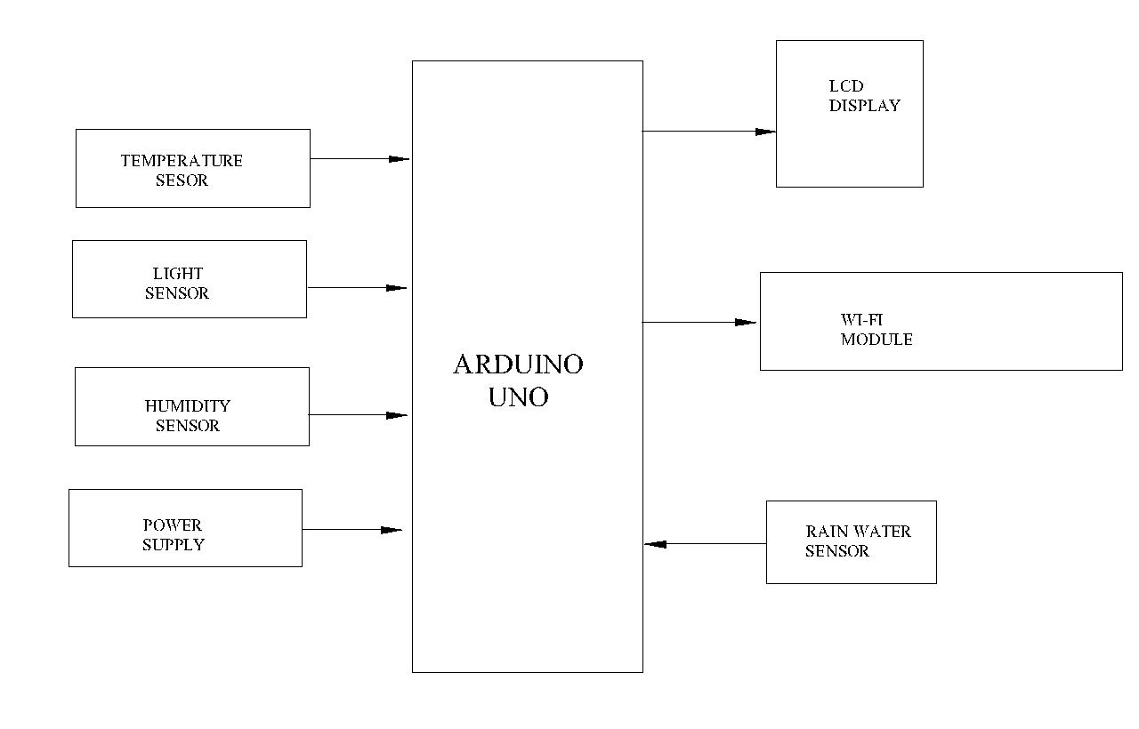


Slide 4

COMPONENTS REQUIRED
ARUDINO CONTROLLER
WIFI MODULE(ESP8266)
TEMPERATURE SENSOR
HIUMDITY SENSOR
RAIN WATER SENSOR
POWER SUPPLY
LCD DISPLAY

Slide 5
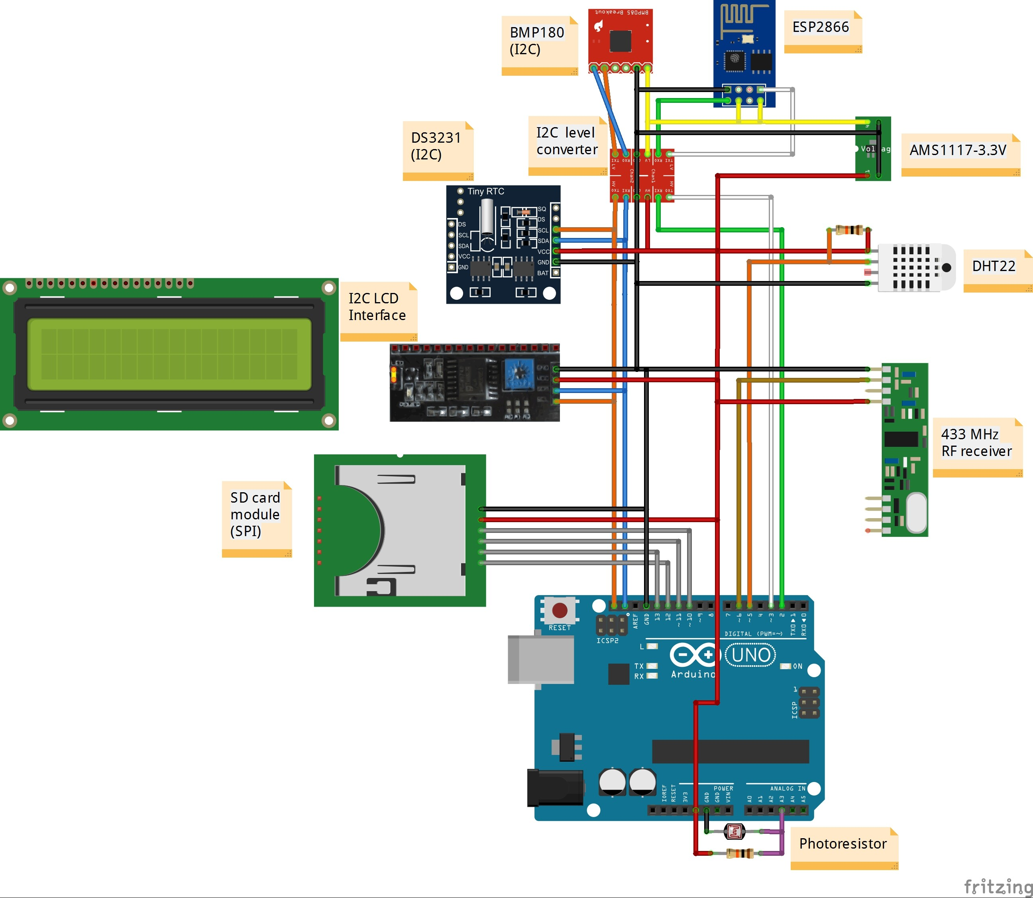
Overall diagram circuit

Slide 6
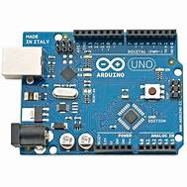
ARUDINO CONTROLLER
Arduino is an open-source hardware and software company, project, and user community that designs and manufactures single-board microcontrollers and microcontroller kits for building digital devices.
Its hardware products are licensed under a CC BY-SA license, while the software is licensed under the GNU Lesser General Public License (LGPL) or the
The microcontrollers can be programmed using the C and C++ programming languages, using a standard API which is also known as the Arduino Progrmming Language, inspired by the Processing language and used with a modified version of the Processing IDE.
In addition to using traditional compiler tool chains, the Arduino project provides an integrated development environment (IDE) and a command line tool developed in Go.

Slide 7
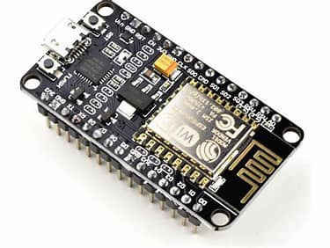
ESP8266(WIFI MODULE)
The ESP8266 is a low-cost Wi-Fi microchip with built-in TCP/IP networking software and microcontroller capability, produced by Espressif Systems in Shanghai,China
The ESP8266 community created an add-on for the Arduino IDE that allows you to program the ESP8266 using the Arduino IDE and its programming language.
This makes it a popular choice for IoT applications given its low cost, small size, and adaptability with embedded devices
It was popularized in the English-speaking maker community in August 2014 via the ESP-01 module, made by a third-party manufacturer Ai-Thinker

Slide 8
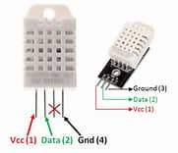
DHT SENSOR
The DHT sensor, which stands for Digital Humidity and Temperature, is a low-cost digital sensor used for sensing temperature and humidity.
It can be easily interfaced with any microcontroller such as Arduino, Raspberry Pi, etc., to measure humidity and temperature instantaneously.
There are two main types of DHT sensors:
DHT11 and DHT22. Both sensors are very similar,
but the DHT22 is more accurate and has a wider range of temperature and humidity.
The DHT11 sensor can either be purchased as a sensor or as a module.
The sensor comes with a 4-pin package out of which only three pins will be used whereas the module will come with three pins

Slide 9
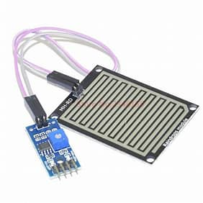
RAIN WATER SENSOR
A rain sensor, also known as a raindrop sensor, is a device used to detect rainfall
The rain sensor is used in various fields like automation, irrigation, automobiles, communication, etc.
It is used as a water preservation device and is connected to the irrigation system to shut down the system in the event of rainfall.
This sensor is used to guard the internal parts of an automobile against the rainfall as well as to support the regular windscreen wiper’s mode.
This sensor is used in specialized satellite communications aerials for activating a rain blower over the opening of the aerial feed, to get rid of water droplets from the mylar wrap to keep pressurized as well as dry air within the waveguides².

Slide 10
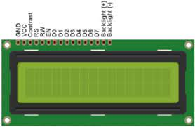
Display

Slide 11
Image SLide
LCD DISPLAY
A display device is an output device which is for
presentation of information in visual or
tactile form.
When the input information is supplied has an
electrical signal the display is called an
electronic display.

Slide 12
Advantage
Real time data collection
Higher accuracy
Wider coverage
Reduced response time
Cost effectiveness
Incresed safety

Slide 13
Apllication
Weather forecasting
Home automation
Heathcare
Education
Agriculture
Travel & Tourism

Slide 14
QUERY!...

Slide 15
THANK YOU

